Slide 1

Evaluating Large Language Models Trained on Code (GPT-Codex)
Mrinal Mathur

Slide 2
Contents
Introduction
Language/Sequence Modeling
Data Collection and Finetuning Data
Human Evaluation
Sandbox area
Sampling and Pass@K Metrics
Results
Code.Ai work.
Future work and Limitation

Slide 3
Introduction
What is this paper about?
GPT language model finetuned on publicly available code from GitHub, and study its Python code-writing capabilities. A distinct production version of Codex potheyrs GitHub Copilot.
300M to 12B parameters GPT-style models pre-trained on 159GB Github data.
How do they quantify?
HumanEval dataset, measures the functional correctness of programs generated from docstrings and function headers
APPS dataset, same as above but natural language descriptions
How does it improve on prior work?
Codex solves 28.8% of HumanEval problems
GPT-J solves 11.4%
GPT-3 solves 0%

Slide 4
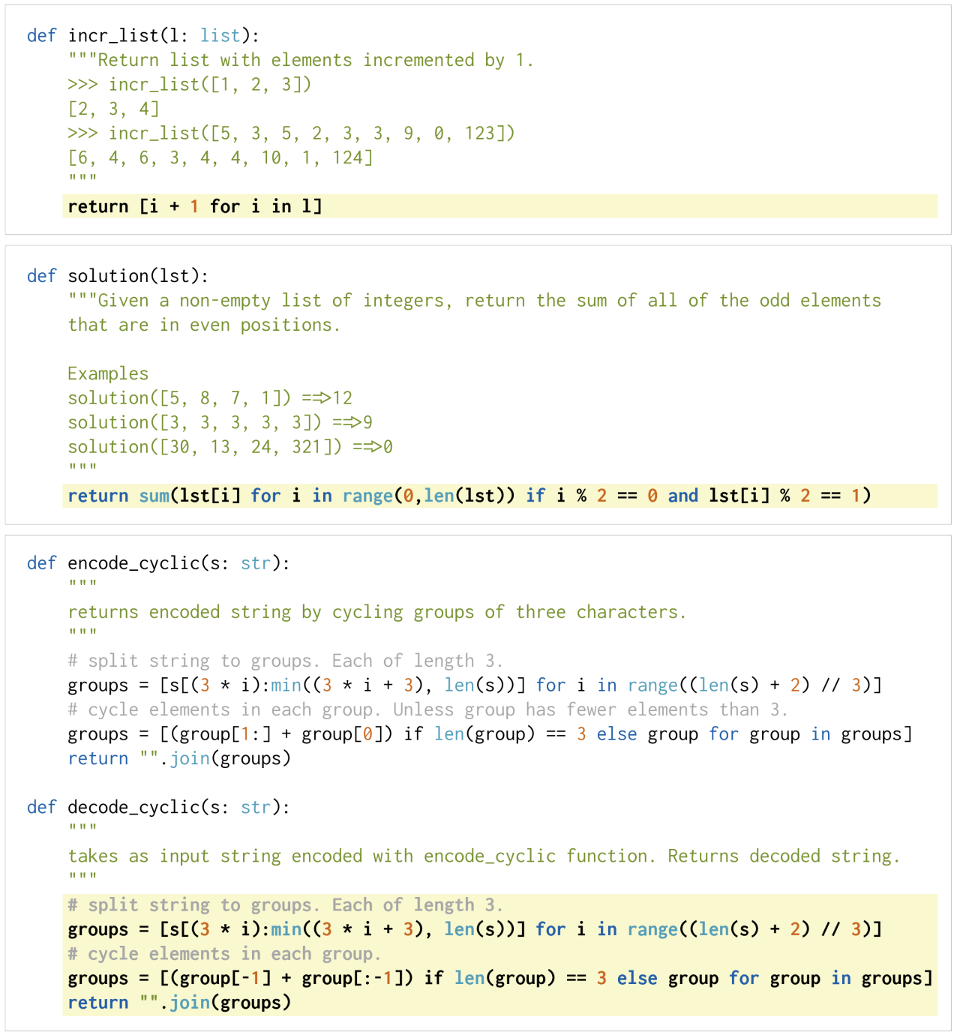
Notes:
This is what the code of the model is being trained to generate.
Focus on the tasks of generating standalone python functions from docstring and evaluate the correctness of the code samples automatically through unit tests.

Slide 5
Language/Sequence Modeling
GPT-3 is a language model, which means that, using sequence transduction, it can predict the likelihood of an output sequence given an input sequence. This can be used, for instance to predict which word makes the most sense given a text sequence.
“i am going for a walk outside to get some <mask>”
Notes:
GPT-3 are mostly trained on

Slide 6
Language/Sequence Modeling
Datasets:
Github Data
The Pile: contains python as theyll as SOF problems
“there are more than ten public repositories containing solutions to Codeforces problems, which make up part of the recently proposed APPS dataset”

Slide 7
Data Collection
Fine-tune from GPT-3
Same performance as training from scratch, but converges faster
Train for 100 billion tokens
Uses GPT-3 tokenizer
With additional special tokens for representing whitespace
“they did not observe improvements when starting from a pre-trained language model, possibly because the finetuning dataset is so large”
Notes:
Since Codex is evaluated on natural language prompts, they hypothesized that it would be beneficial to fine-tune from the GPT-3 (Brown et al., 2020) model family, which already contains strong natural language representations. Surprisingly, they did not observe improvements when starting from a pre-trained language model, possibly because the finetuning dataset is so large. Nevertheless, models fine-tuned from GPT converge more quickly, so they apply this strategy for all subsequent experiments.
same learning rate as the corresponding GPT model, with a 175 step linear warmup and cosine learning rate decay

Slide 8
Data Collection and Finetuning Data
Dataset was collected in May 2020 from 54 million public software repositories hosted on GitHub, containing 179 GB of unique Python files under 1 MB.
Apply filtering criteria
average line length
maximum line length
small number of alphanumeric characters
159 GB of Python files
How big Is 159 GB of code data?
Keras code: “timeseries classification with a transformer model” :
34Kb – x4.7 million files of this size

Slide 9
Evaluation
Human Eval dataset (https://github.com/openai/human-eval)
163 hand-written Python coding problems, with unit tests!
Solution marked as correct if it passes all unit tests
Notes:
evaluate functional correctness on a set of 164 handwritten programming problems, which they call the HumanEval dataset. Each problem includes a function signature, docstring, body, and several unit tests, with an average of 7.7 tests per problem. It is important for these tasks to be hand-written, since our models are trained on a large fraction of GitHub, which already contains solutions to problems from a variety of sources. For example, there are more than ten public repositories containing solutions to Codeforces problems, which make up part of the recently proposed APPS dataset

Slide 10
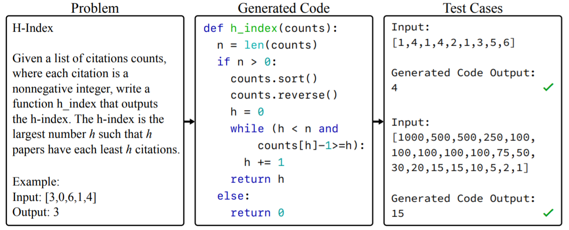
Evaluation
APPS dataset (https://github.com/hendrycks/apps)
5000/5000 train/test examples
Two metrics:
Number of times a solution passes all test cases (“strict accuracy”)
Number of test cases passed
Three input-output examples per example
Notes:
It’s hard for the text and

Slide 11
Sandbox environment
Goal: they try to prevent these programs from modifying, gaining persistence on, accessing sensitive resources on, or exfiltrating data from a host or network.
they selected the gVisor container runtime (Lacasse, 2018) as the main host protection component since container runtimes like Docker can share host resources with containers, a malicious container could potentially compromise a host
Notes:
Since publicly available programs have unknown intent and generated programs are often incorrect, executing these programs poses a security risk. Indeed, GitHub is known to contain malicious programs that alter or change their environments.

Slide 12
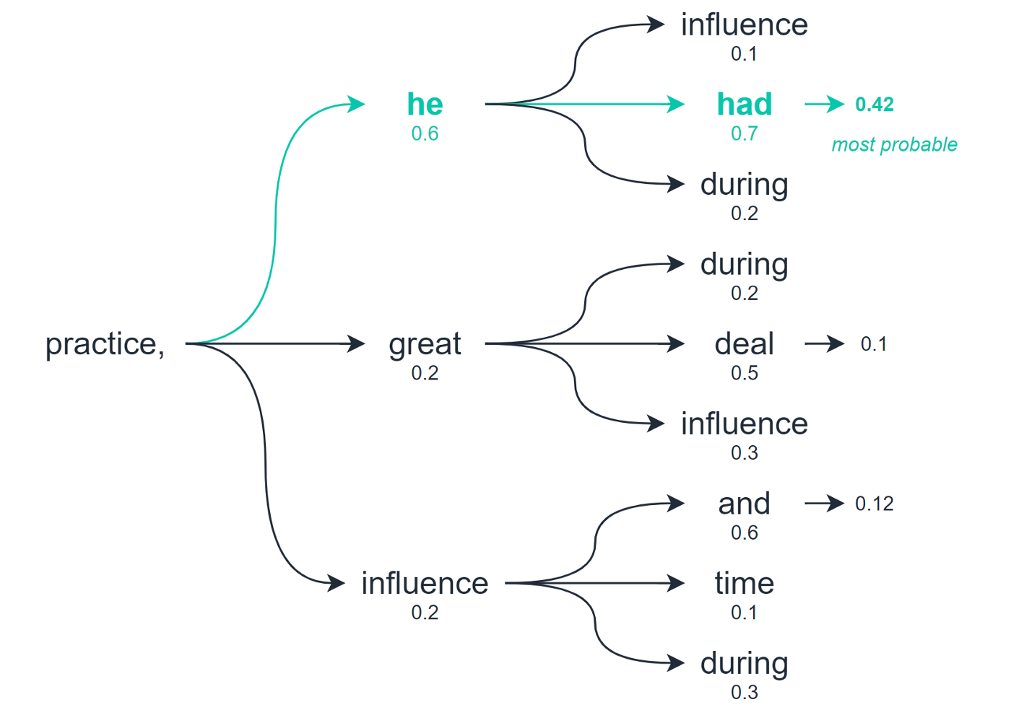
Repeated Sampling
allows us to explore multiple levels of our output before selecting the best option.
checks for multiple word/tokens into the future and assesses the quality of all of these tokens combined.
Source: https://towardsdatascience.com/the-three-decoding-methods-for-nlp-23ca59cb1e9d

Slide 13
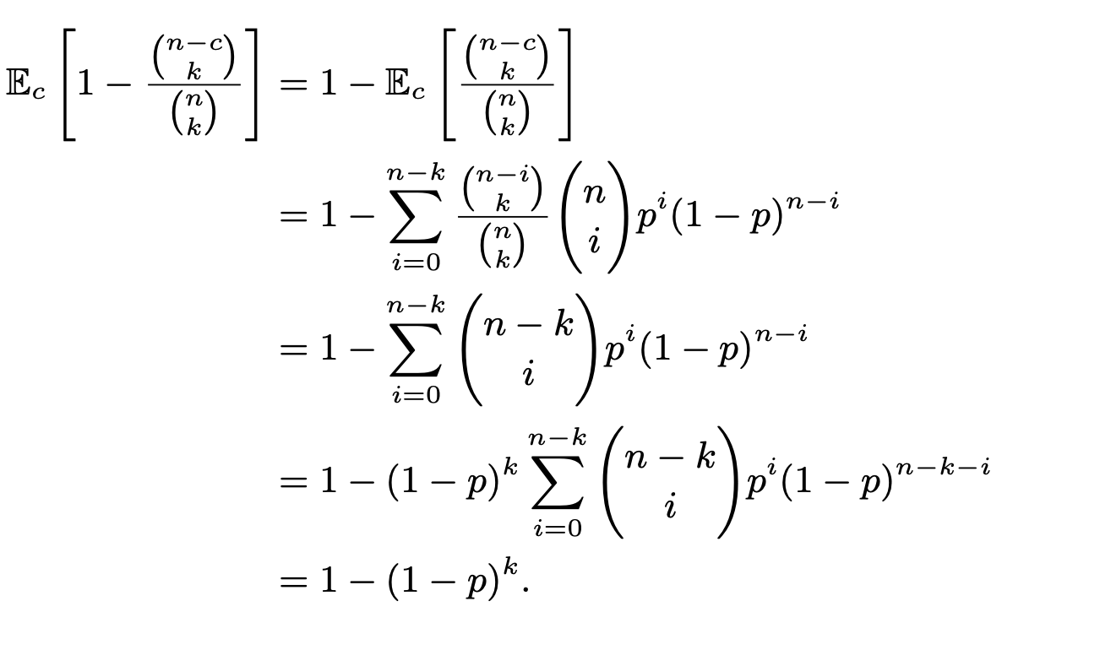
Pass@K
evaluate functional correctness using the pass@k metric, where k code samples are generated per problem, a problem is considered solved if any sample passes the unit tests, and the total fraction of problems solved is reported.
But this is baised!!
evaluate pass@k, they generate n ≥ k samples per task count the number of correct samples c ≤ n which pass unit tests, and calculate the unbiased estimator
Notes:
Hotheyver, computing pass@k in this way can have high variance. Instead, to
(in this paper, they use n = 200 and k ≤ 100),

Slide 14
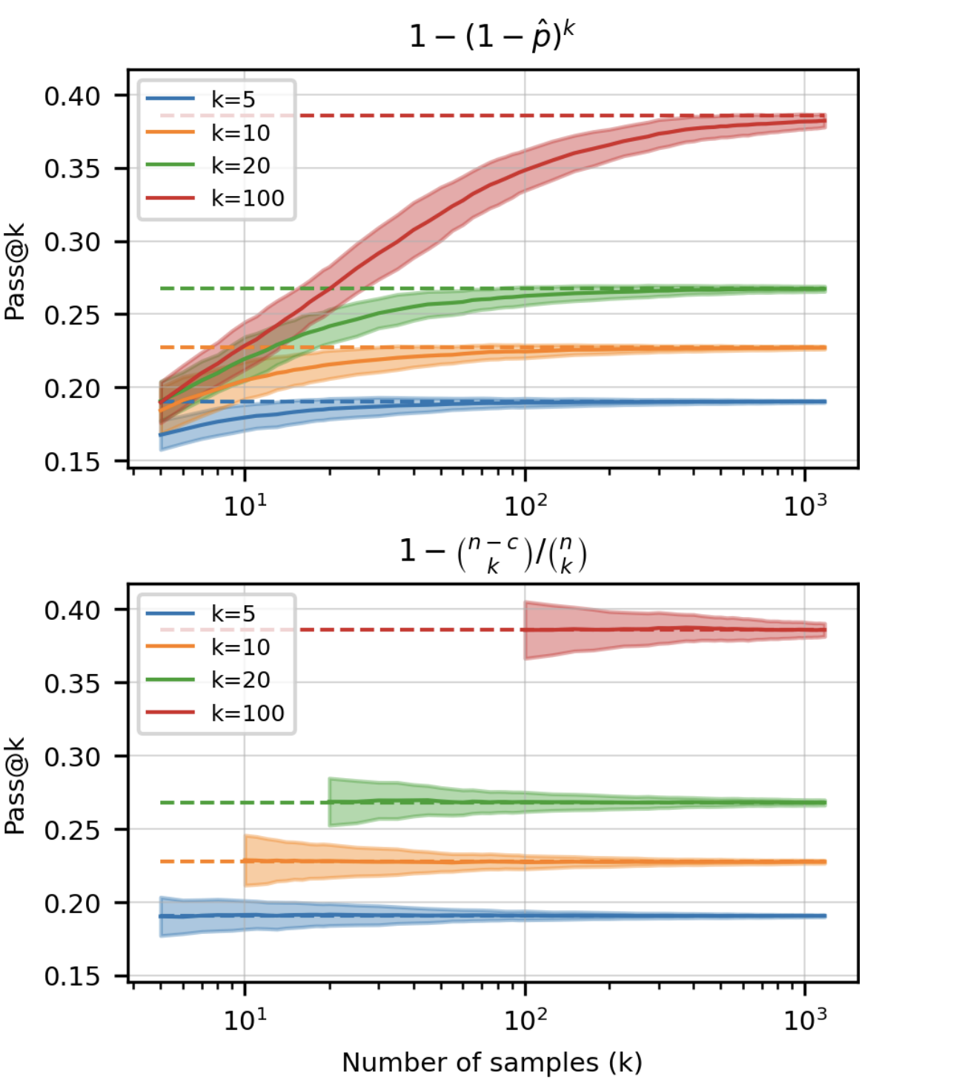
Pass@K
Notes:
. Comparing the amount of bias and variance of two estimators of pass@k. While the top expression may look correct, it underestimates the true value by a considerable margin. The unbiased estimator may have a slightly higher variance initially but allows for a fair comparison across different numbers of samples

Slide 15
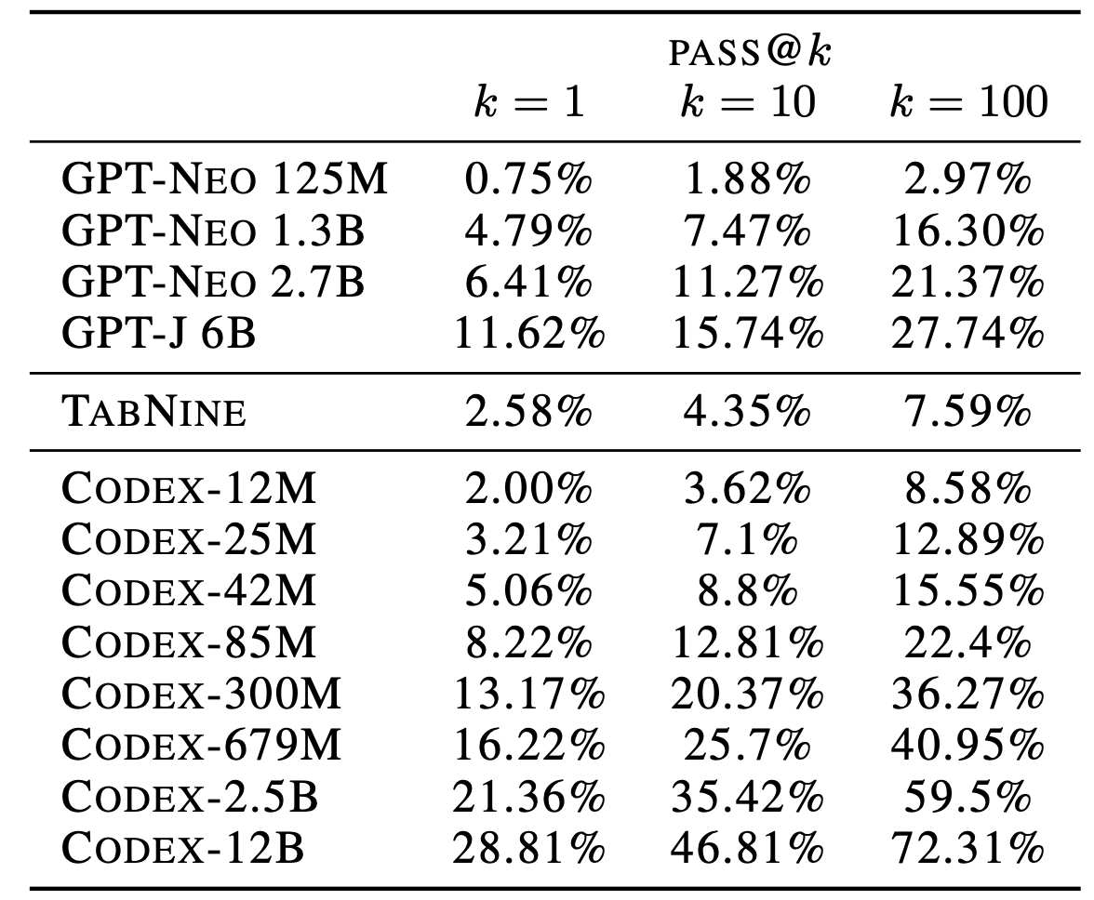
Results : On HumanEval Dataset
Notes:
GPT-J pass@1 is between Codex-85M and Codex300M performance.
Makes sense because Codex is trained on pyton code while gpt neo and j are trained on pile dataset
Codex 2.5 has the same parameters as in Neo 2.7 but it has 4 times the performance basically.

Slide 16
Results : Pass@K
Generate a single solution (pass@1), check if it passes:
GPT-3 → 0%
Codex-S (fine-tuned on competitive programming examples) → 37.7%
Generate 100 solutions (pass@100), check if the one with the highest log probability passes:
GPT-3 → 0%
Codex-S → 44.5%
Generating 100 solutions, check if any pass:
GPT-3 → 0%
Codex-S → 77.5%
Notes:
GPT-J pass@1 is between Codex-85M and Codex300M performance.
Codex-S = trained on APPS datsset
Do it in same domain and it performs better .

Slide 17
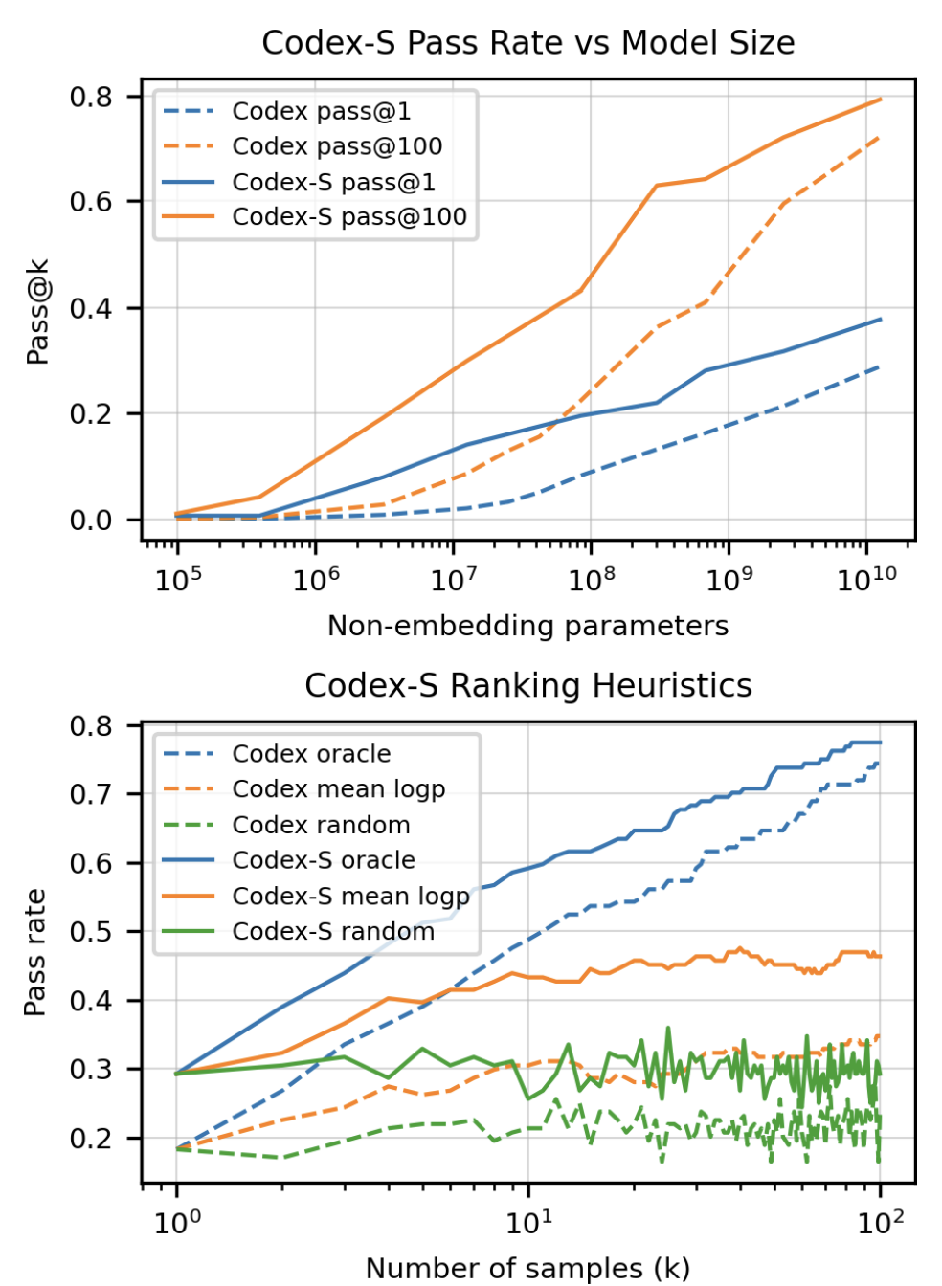
Results : Scaling Laws!!
Notes:
They have used backtranslation as well
Mean logp means that the code which has the lowest test loss or test complexity is much better than choosing any random test.

Slide 18
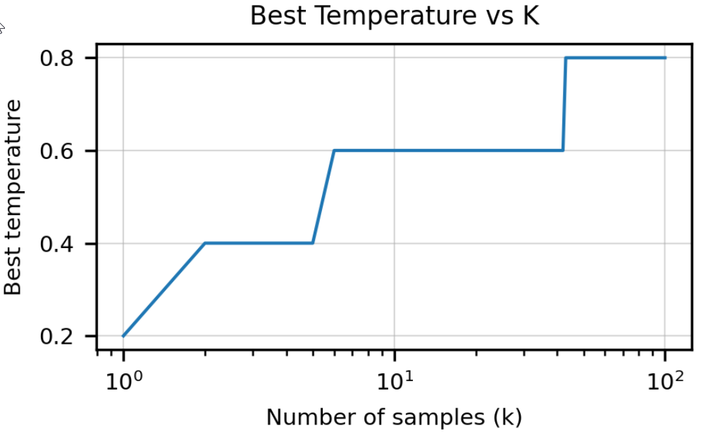
Results : Best Temperature!
Notes:
They have used backtranslation as well
Mean logp means that the code which has the lowest test loss or test complexity is much better than choosing any random test.

Slide 19
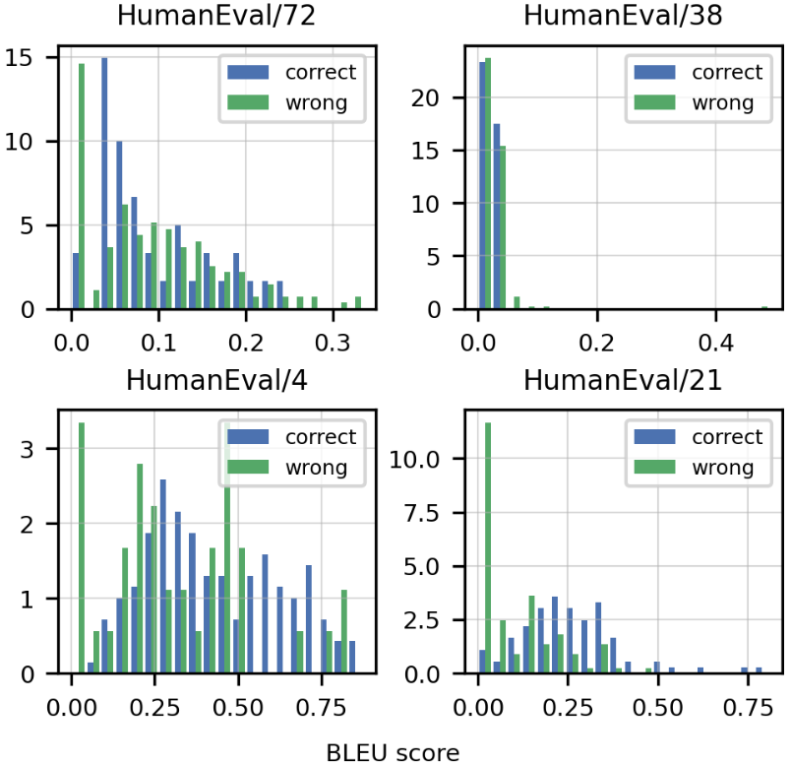
Results : BLEU Score
distributions of BLEU scores for correct and incorrect solutions,
we notice significant overlap
BLEU score probability densities for correct (blue) and wrong (green) solutions from Codex-12B for 4 random tasks from HumanEval.
Notes:
Since an incorrect solution is guaranteed to be functionally inequivalent to the reference solution, we conclude that improvements in BLEU score may not indicate improved rates of functional correctness in practice.
Note that the distributions are not cleanly separable, suggesting that optimizing for BLEU score is not equivalent to optimizing for functional correctness
The Bilingual Evaluation Understudy Score, or BLEU for short, is a metric for evaluating a generated sentence to a reference sentence.
A perfect match results in a score of 1.0, whereas a perfect mismatch results in a score of 0.0.
The score was developed for evaluating the predictions made by automatic machine translation systems. It is not perfect, but does offer 5 compelling benefits:
It is quick and inexpensive to calculate.
It is easy to understand.
It is language independent.
It correlates highly with human evaluation.
It has been widely adopted.
https://machinelearningmastery.com/calculate-bleu-score-for-text-python/

Slide 20
Limitations
Sample efficiency
Humans learn from significantly less code
Generates code that:
is syntactically incorrect
uses undefined/out-of-scope variables
Performance drops with length/complexity of docstring

Slide 21
Hazards
Human Over-reliance
Generates code that looks correct, but isn’t
Misalignment
Deliberately suggests incorrect code
Bias
Can generate toxic comments
Economic Impact
Insecure Code
Environmental Impact
Legal Implications

Slide 22

GPT-CODE-CLIPPY

Slide 23
Introduction
GPT-Code-Clippy (GPT-CC) is an open source version of GitHub Copilot, a language model -- based on GPT-3, called GPT-Codex -- that is fine-tuned on publicly available code from GitHub.

Slide 24
Dataset
The dataset used to train GPT-CC is obtained from SEART GitHub Search using the following criteria:
>10 GitHub stars
>2 commits
Must have a licence
Exclude forks
Size < 70708 bytes
These repositories are then combined with all of the GitHub repositories contain in The Pile.
The repositories are then filtered for duplicate files. Filtering is performed by regexing each file in each repository to obtain a list of "variables" (the tokens which only contain alphanumeric characters) and then filtering out any files which contain the same sequence of "variables. The deduplication script is available here.
The final dataset is available here. The dataset without the duplicates filtered out is also available here.
The datasheet discussing in more detail the construction, usage, and limitation of the dataset can be found here. We hope to get it officially into Huggingface's datasets library soon!
Notes:
we use the Causal Language Modelling objective to train the model.

Slide 25
How did we do it?
To train our model, we used Huggingface's Transformers library and specifically their Flax API to fine-tune our model on various code datasets including one of our own, which we scraped from GitHub.
Modifying the batch size and learning rate as suggested by people in EleutherAI's discord server when fine-tuning the model. We decided to fine-tune rather than train from scratch since in OpenAI's GPT-Codex paper, they report that training from scratch and fine-tuning the model are both equally in performance. However, fine-tuning allowed the model to converge faster than training from scratch. Therefore, all of the versions of our models are fine-tuned.
Our training scripts are based on the Flax Causal Language Modelling script from here. However, we heavily modified this script to support the GPT3 learning rate scheduler, weights and biases report monitoring, and gradient accumulation since we only had access to TPUv3-8s for training and so large batch sizes (1024-2048) would not fit in memory.
Notes:
Please visit our datasets page for more information regarding them. We used the hyperparameters discussed in the GPT-3 small configuration from EleutherAI's GPT-Neo model.
Our causal language modeling (CLM) task consists of a Transformer language model trained to model the probability of a word given the previous words in a sentence P(wt |w1, . . . , wt−1, θ). While recurrent neural networks obtain state-ofthe-art performance on language modeling benchmarks (Mikolov et al., 2010; Jozefowicz et al., 2016), Transformer models are also very competitive (Dai et al., 2019). In the case of LSTM language models, backpropagation through time (Werbos, 1990) (BPTT) is performed by providing the LSTM with the last hidden state of the previous iteration. In the case of Transformers, previous hidden states can be passed to the current batch (Al-Rfou et al., 2018) to provide context to the first words in the batch. However, this technique does not scale to the cross-lingual setting, so we just leave the first words in each batch without context for simplicity

Slide 26
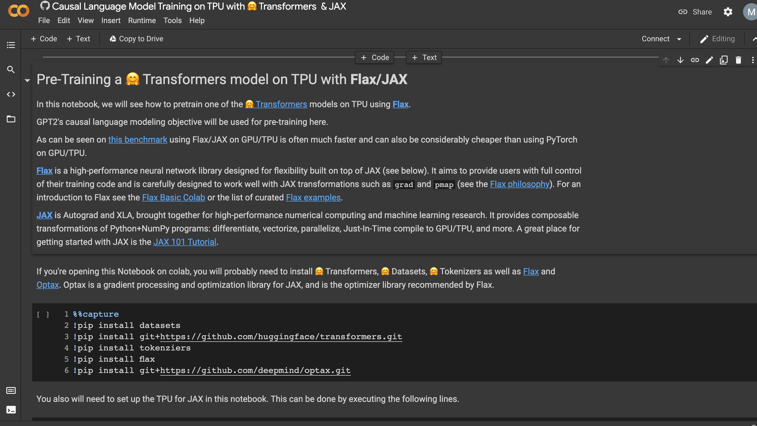

Slide 27
Evaluation
Model | pass@1 | pass@2 | pass@5 | pass@10
EleutherAI/gpt-neo | 0.12% | 0.24% | 0.61% | 1.22%
gpt-neo-125M-apps | 0.06% | 0.12% | 0.30% | 0.61%
dedup-filtered-no-resize-2048bs | 0.00% | 0.00% | 0.00% | 0.00%
1024-filtered | 0.00% | 0.00% | 0.00% | 0.00%
dedup-2048 | 0.00% | 0.00% | 0.00% | 0.00%
Notes:
The models are also evaluated on the APPS and HumanEval datasets

Slide 28
Demo

Slide 29

GPT-Code-Clippy
https://github.com/ncoop57/gpt-code-clippy
https://github.com/ncoop57/code-clippy-vscode

Slide 30
Opinion and Questions
The pile dataset has only 5GB data but still able to perform really good.
Filtering playes out to be a huge role.
If by adding multiple languages, Codex performances might improve
Something like Universal Abstract tree might help
Didn’t mention Microsoft’s CodeBleu (very weird!): separate metrics that captures symantics and syntax than just normal Bleu
Notes:
Having syntactical sharing may help, like javascript or C# but cant think of any which resembles with python
They did some specific filtering
People from MS were not even mentioned or co author from here.

Slide 31

~Fin~

